Slide 1
Lecture 3 – AI Search Techniques
AY 2025-26

Slide 2
Lesson Outline
Graph model
Graph Algorithms
Breadth First Search (BSF)
Dijkstra’s Algorithm and Uniform Cost Search
Best First Search
A* Search

Slide 3
Graph Model
Graph model
G = (V, E)
V is a set of vertices (nodes)
E is a set of edges; each edge is a pair of vertices
Example:
V = {1, 2, 3, 4}
E = {(1, 2), (1, 3), (2, 4), (4, 1)}
1
2
3
4

Slide 4
Graph Model: Directed or Undirected
Undirected graph
The edges do not have a specific direction
That means edges can travel in both ways
E.g. Facebook friend relationship
Directed graph
Edges have a specific direction
Each edge can travel in one way
E.g. Instagram follower relationship
1
2
3
4
1
2
3
4

Slide 5
Adjacency Matrix
Adjacency matrix: the data structure to express a graph
It is a |V| X |V| matrix
Example:
 | 1 | 2 | 3 | 4
1 | 0 | 1 | 1 | 0
2 | 0 | 0 | 0 | 1
3 | 0 | 0 | 0 | 0
4 | 1 | 0 | 0 | 0
1
2
3
4

Slide 6
Adjacency List
Adjacency list: a list data structure to represent a graph
Vertex u has its adjacency list Adj[u], which contains each vertex v being adjacent to u
E.g., Adj[4] = {1, 2}
1
2
1 | Adjacent to | 3
2 | Adjacent to | 1
3 | Adjacent to
4 | Adjacent to | 1, 2
3
4

Slide 7
Graph Analytics
Searching
Clustering / Partitioning
Shortest path
The shortest path between two vertices
Network analysis
etc

Slide 8
2. Graph Algorithms
Breadth-First Search (layer by layer)
Dijkstra’s Algorithm and Uniform Cost Search
Best-first Search
A* Search
L3 – AI Search Techniques

Slide 9
Uninformed Search & Informed Search
Uninformed Search:
also known as blind search
does not use any domain-specific knowledge or information to guide the search
is often used when little or no information is available about the problem domain.
E.g., Breadth-first search, Dijkstra’s Algorithm
Informed Search:
known as heuristic search
uses domain-specific knowledge or information (usually heuristic functions) to guide the search
E.g., A* search, greedy search

Slide 10
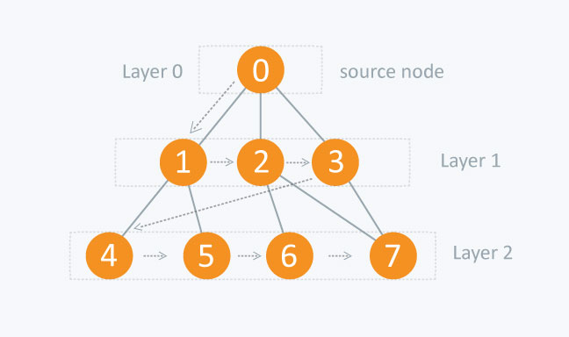
Breadth-first Search (BFS)
Problem:
Given a source vertex 𝑠 in a graph 𝐺=(𝑉,𝐸) the objective is to visit all vertices closer to 𝑠 before any farther vertices.
Concept: BFS explores the graph layer by layer:
Layer 0: Consists of only the starting vertex s.
Layer 1: Contains the neighbors of s.
Layer 2: Comprises the neighbors of Layer 1 vertices that do not already belong to Layer 0 or 1.
Layer 3: Follows the same process, and so on.
Source:
https://www.hackerearth.com/practice/algorithms/graphs/breadth-first-search/tutorial/

Slide 11
Breadth First Search (BFS)
Breadth First Search algorithm
Mark all nodes as not visited
Mark startNode visited
Add startNode to the queue
While (queue is not empty):
Remove currentNode from queue
For each nextNode connected to currentNode:
If nextNode is not visited,
Mark nextNode visited.
If nextNode is goalNode, terminate with success
Add nextNode to queue
After all nodes in queue checked, terminate with failure
If terminate with success, return the path found

Slide 12
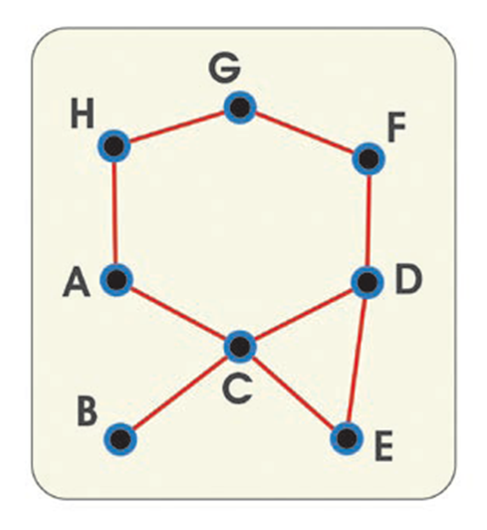
Successful BFS
Example: search from B to G
Visited nodes {B}, queue {B}
Removed B from queue, insert all connected nodes
Visited nodes {BC}, queue {C}
Removed C from queue, insert all connected nodes
Visited nodes {BCADE}, queue {ADE}
Remove A from queue, insert node H (not C, as it had been visited)
Visited nodes {BCADEH}, queue {DEH}
Remove D from queue, insert F
Visited nodes {BCADEHF}, queue {EHF}
Remove E, add nothing (no other nodes to go)
Visited nodes {BCADEHF}, queue {HF}
Remove H, add G, and the goal is found
Visited nodes {BCADEHFG}, queue {FG}
Path: B -> C -> D -> F -> G

Slide 13

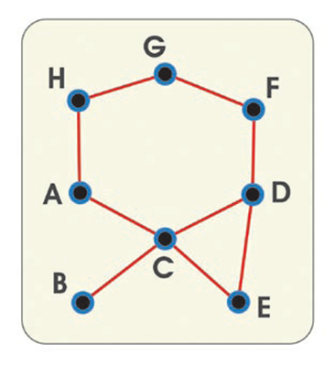
Unsuccessful BFS
Search from B to J
We start from the last iteration in the last example
Visited nodes {BCADEHFG}, queue {FG}
Remove F from queue, no additional node added
Visited nodes {BCADEHFG}, queue {G}
Remove G from queue, no additional node added
Visited nodes {BCADEHFG}, queue {}
The queue is now empty
Therefore, no path exist from B to J

Slide 14

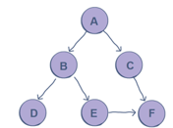

Example: BFS (3)
Run the BSF algorithm
lab3.ipynb (Q.1)
Output
https://www.educative.io/edpresso/how-to-implFement-a-breadth-first-search-in-python ]

Slide 15
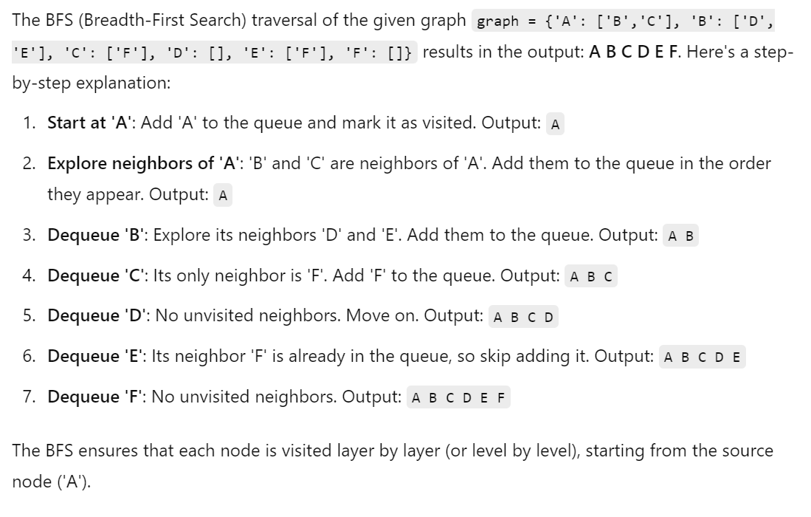
Example: BFS (3)
lab3.ipynb (Q.1)

Slide 16
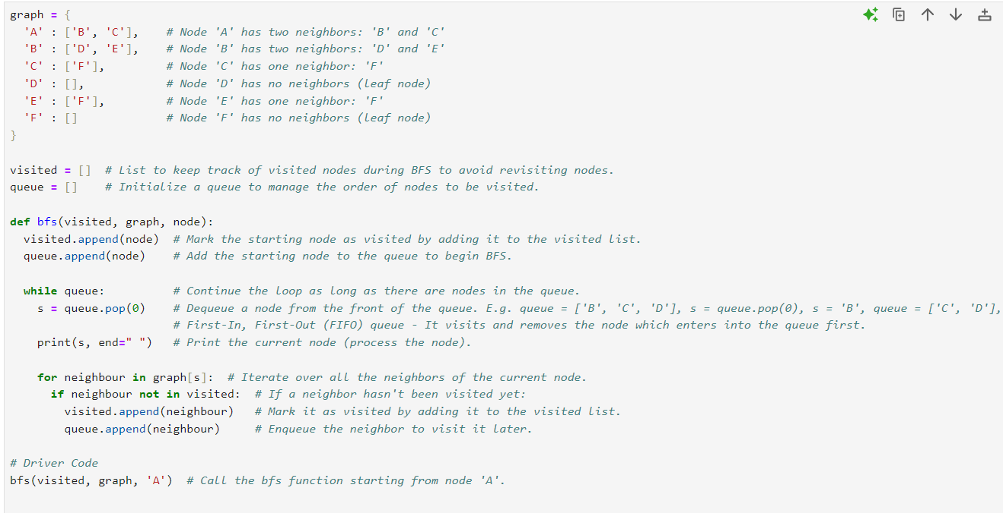

Slide 17
Advantages and Disadvantages of BFS
Advantages
Simple algorithm
Disadvantages
Not efficient
Requires a lot of memory space
Not always getting the best path

Slide 18
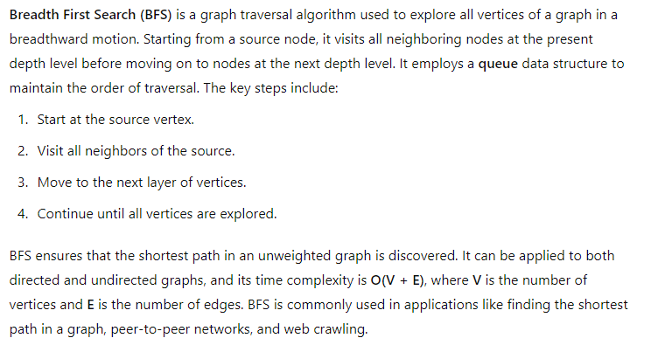

Slide 19
Graph Algorithms
Breadth-First Search
Dijkstra’s Algorithm and Uniform Cost Search shortest path between nodes with different weights/costs.
Best-first Search
A* Search

Slide 20
Dijkstra’s algorithm
Dijkstra's algorithm finds the shortest path by picking the unvisited node with the lowest distance/ cost from start, calculates the distance through it to each unvisited neighbour, and updates the neighbour's distance if smaller.

Slide 21
Dijkstra’s Algorithm Example (1)
Suppose we have the following undirected graph. The initial node is A; the goal node is E.
7
A
B
2
2
2
E
2
4
1
6
C
D

Slide 22
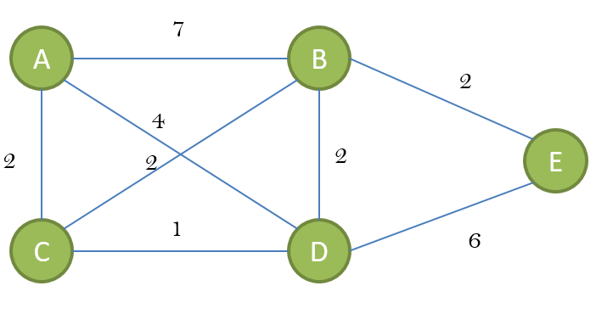
Dijkstra’s Algorithm Example (2)
Initialization:
Start at node AAA, set the distance to AAA as 0.
Set the distance to all other nodes as ∞\infty∞ (infinity).
Current Node: A
 | A | B | C | D | E
 | 0 | ∞ | ∞ | ∞ | ∞

Slide 23
Dijkstra’s Algorithm Example (3)
Explore Neighbors of A:
B: Distance = 0 + 7 = 7
D: Distance = 0 + 4 = 4
C: Distance = 0 + 2 = 2
Updated table:
Move to the unvisited node with the smallest distance: 𝐶C (distance = 2)
 | A | B | C | D | E
 | 0 | ∞ | ∞ | ∞ | ∞
A | 0 | 7 | 2 | 4 | ∞

Slide 24
Dijkstra’s Algorithm Example (4)
Explore Neighbors of C:
D: Distance = 2 + 1 = 3 (better than ∞)
B: Distance = 2 + 2 = 4 (better than 7)
Move to the unvisited node with the smallest distance: D (distance = 3)
 | A | B | C | D | E
 | 0 | ∞ | ∞ | ∞ | ∞
A | 0 | 7 | 2 | 4 | ∞
C | 0 | 4 | 2 | 3 | ∞

Slide 25
Dijkstra’s Algorithm Example (5)
Explore Neighbors of D:
E: Distance = 3 + 6 = 9
 | A | B | C | D | E
 | 0 | ∞ | ∞ | ∞ | ∞
A | 0 | 7 | 2 | 4 | ∞
C | 0 | 4 | 2 | 3 | ∞
D | 0 | 4 | 2 | 3 | 9

Slide 26
Dijkstra’s Algorithm Example (6)
Explore Neighbors of B:
E: Distance = 4 + 2 = 6
 | A | B | C | D | E
 | 0 | ∞ | ∞ | ∞ | ∞
A | 0 | 7 | 2 | 4 | ∞
C | 0 | 4 | 2 | 3 | ∞
B | 0 | 4 | 2 | 3 | 6

Slide 27
Dijkstra’s Algorithm Example (7)
Update the path cost from B → E
Finally shortest path found
A → C → B → E, with path cost = 6
https://algodaily.com/lessons/an-illustrated-guide-to-dijkstras-algorithm/python
 | A | B | C | D | E
 | 0 | ∞ | ∞ | ∞ | ∞
A | 0 | 7 | 2 | 4 | ∞
C | 0 | 4 | 2 | 3 | ∞
B | 0 | 4 | 2 | 3 | 6
E | 0 | 4 | 2 | 3 | 6

Slide 28
Uniform Cost Search (Dijkstra’s algorithm for large graph)
Uniform cost search is a variant of Dijkstra’s algorithm
While Dijkstra's algorithm searches for shortest paths from root to every other node in a graph, uniform cost searches for shortest paths in terms of cost from root to goal
Uniform cost search is used in large or infinite graphs
Uniform cost search is commonly used in artificial intelligence

Slide 29
Uniform Cost Search
Uniform cost search algorithm
Make use of priority queue
Starting from starting node, add all adjacent nodes to the priority queue, remove one with least cost
repeat for the node with the least cost
When the goal is reached, continue (as there may be alternative paths with lower costs)
Stop when the goal node is removed
Obtain the optimal path

Slide 30
Advantages and Disadvantages of Uniform Cost Search
Advantages
Optimal path obtained (with minimum cost)
Disadvantages
Not efficient, often need more steps to find a path
May stick to an infinite loop if there is a path with infinite zero cost sequence

Slide 31
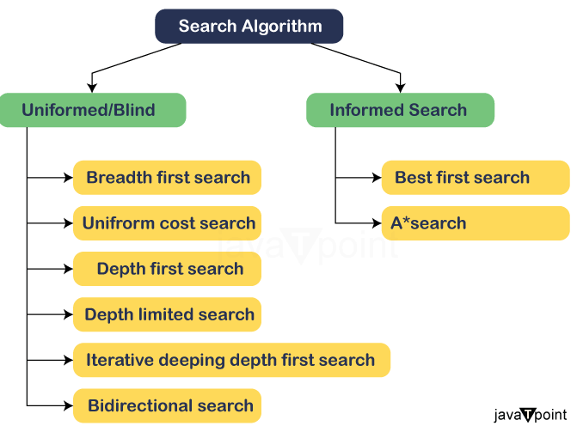
Graph Algorithms
Breadth-First Search
Dijkstra’s Algorithm and Uniform Cost Search
Best-first Search (heuristic function min h(n) )
A* Search

Slide 32
Best First search (1)
Best first search (Greedy algorithm) is a search algorithm which explores a graph by expanding the most promising node chosen according to a specified rule.
In Best first search, node selection on every step is based on minimizing a heuristic function h(n)
The heuristic function h(n) is a cost estimate. E.g. it may represent the physical distance/ time/ expenditure required, or the energy consumed when a monster in a game move from the node to the goal

Slide 33
Best First search (2)
Best First Search uses distance to goal not distance from start
Best first search uses the estimated distance to goal instead of the distance from the starting point in searching
Obstacles can cause a best first search to double back. It does not always return the best path
In games, it is suitable for hand-held game with limited processing power

Slide 34
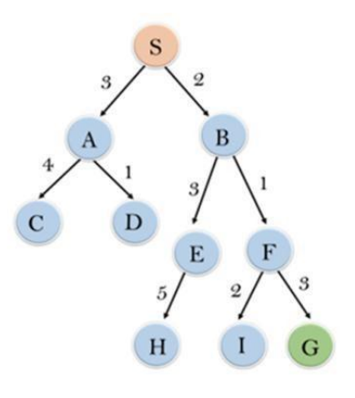
Problem (1)
Problem: Find a good path from S to G.
Uniform cost search, g(n) refers to the actual cost from the start node S to a given node n.
Source:
https://www.javatpoint.com/ai-informed-search-algorithms

Slide 35
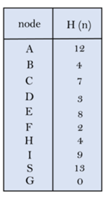
Problem (2)
Given the follow heuristic cost information:
Greedy best-first search, the algorithm only considers the heuristic cost, denoted as h(n)

Slide 36
Algorithm
Best first search algorithm:
Make use of priority queue
Starting from starting node, add all adjacent nodes to the priority queue, calculate the distance from goal, remove one with least value for the heuristic function
repeat for the node just removed
Stop when the goal is reached
Obtain the path

Slide 37
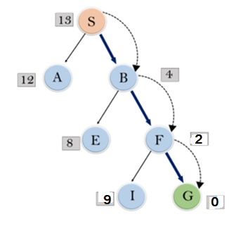
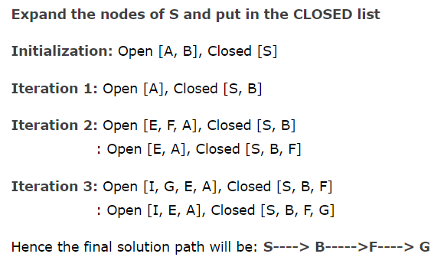
Best-First Search Complete Solution

Slide 38
Advantages and Disadvantages of Best First Search
Advantages
Very efficient, fast exploration of nodes to reach the goal
Having low memory requirements
Disadvantages
Does not guarantee the best path, but often return a best path under certain conditions, e.g. in games with convex obstacles only
Likely to have inaccurate results

Slide 39
Graph Algorithms
Breadth-First Search
Dijkstra’s Algorithm and Uniform Cost Search
Best-first Search
A* Search (cost + h(n))

Slide 40
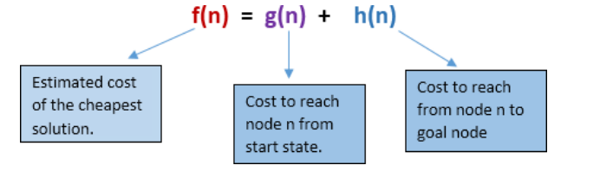
A* search algorithm combines both heuristic h(n) and the actual cost g(n), making it more efficient than UCS and greedy search. By minimizing the total cost and heuristic estimates, it expands fewer nodes and provides an optimal solution faster. This approach ensures that the search finds the shortest path while considering both cost to reach a node and the estimated distance to the goal.

Slide 41
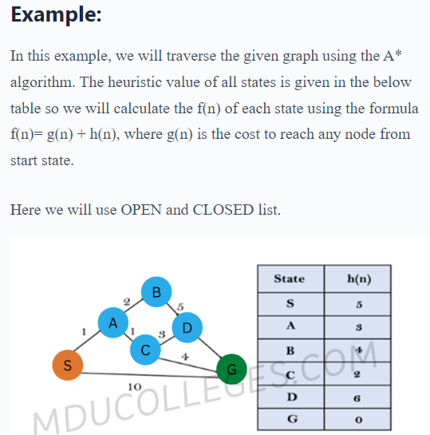

Slide 42
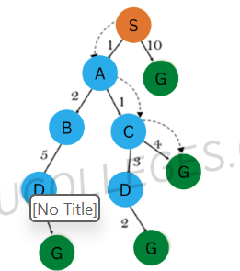
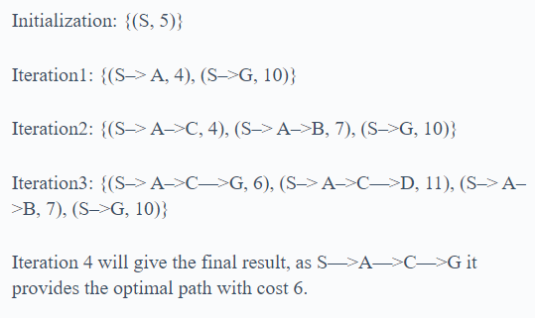

Slide 43
Points to remember:
A* algorithm returns the path which occurred first, and it does not search for all remaining paths.
The efficiency of A* algorithm depends on the quality of heuristic.
A* algorithm expands all nodes which satisfy the condition f(n) ≤ f(goal)
Complete: A* algorithm is complete as long as:
Branching factor is finite.
Cost at every action is fixed.

Slide 44
A* Search
A* search was created as part of the Shakey project, which had the aim of building a mobile robot that could plan its own actions. Nils Nilsson originally proposed using the Graph Traverser algorithm for Shakey's path planning.

Slide 45
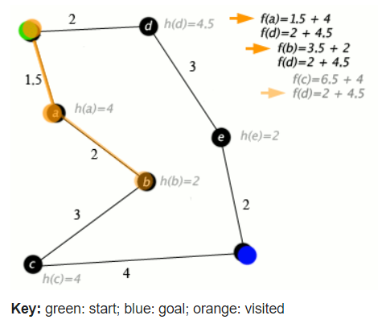
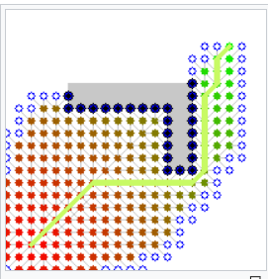
A* Search makes use of both distance from start and distance to goal
Source:
https://en.wikipedia.org/wiki/A*_search_algorithm
Click for Demo

Slide 46
Example (1)
10.2
6
3
A
4
B
4
C
3
12
0
S
5
G
5
4
4.8
D
2
E
4
F
9
7
4

Slide 47
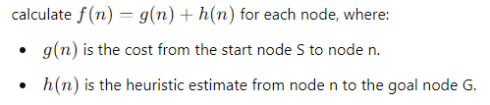
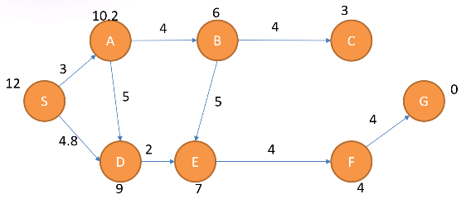
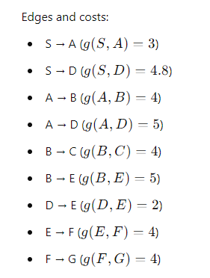
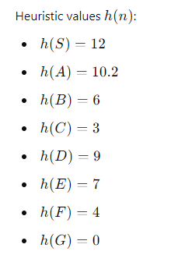

Slide 48
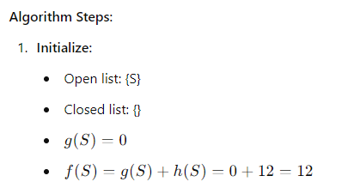
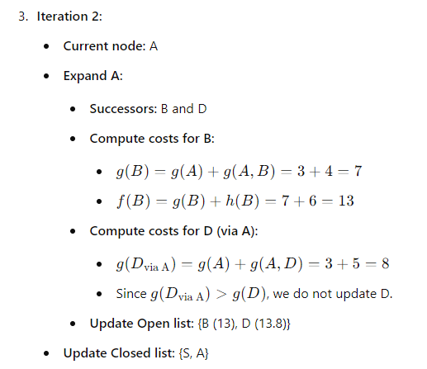
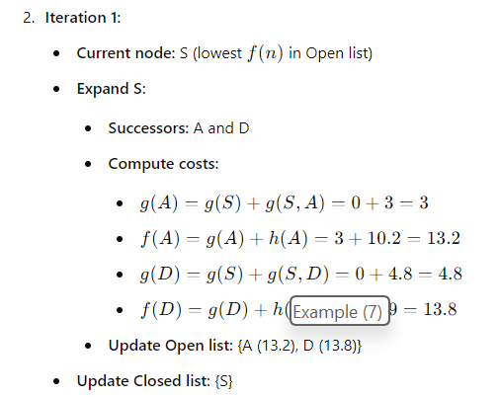

Slide 49
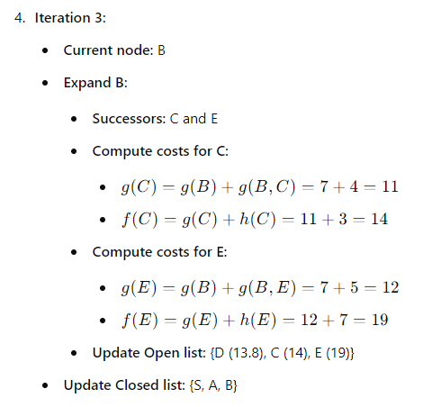
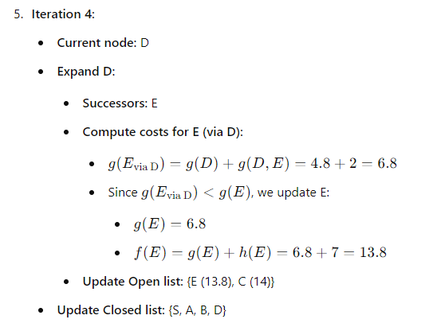

Slide 50
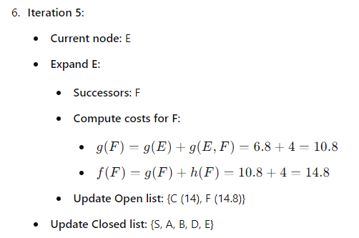
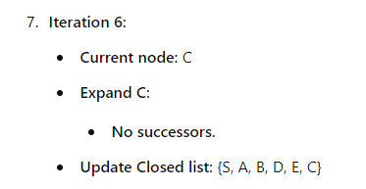

Slide 51
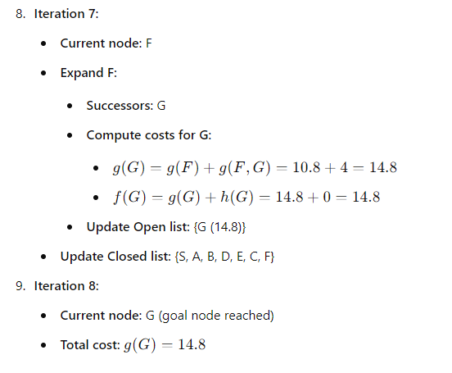
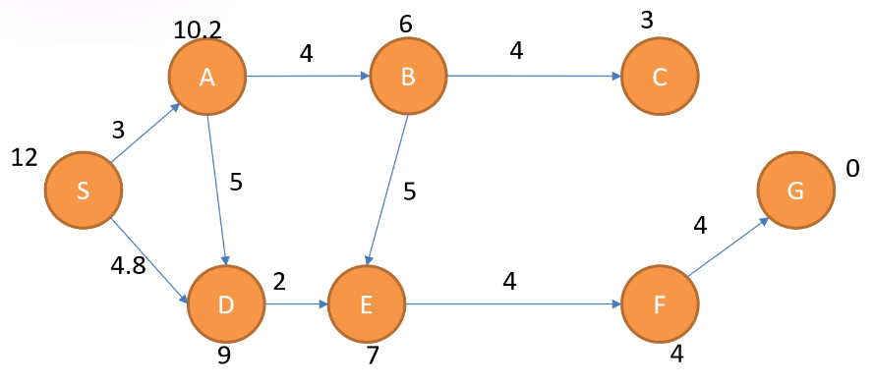
Reconstructed Path:
S → D → E → F → G
Total cost from S to G: 14.8

Slide 52
S
A
D
13.2
13.8
Reconstructed Path:
S → D → E → F → G
Total cost from S to G: 14.8
13
B
D
17
A
E
13.8
19
C
E
14.8
B
F
14
19
17
14.8
G

Slide 53
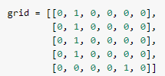
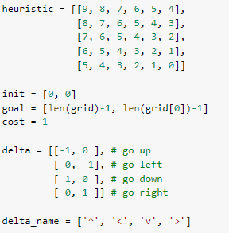
Example 2
Define the grid
lab3.ipynb (Q.3a)
Define the heuristics and parameters
Note: same as Best First Search except:
cost = 0 -> cost = 1
Problem: a 5*6 maze:
In the grid, 1 represents barrier e.g. wall in the maze
1 : cannot go through
0 : can go through]
https://github.com/ninopereira/A_Star_Python/blob/master/A_star.py

Slide 54
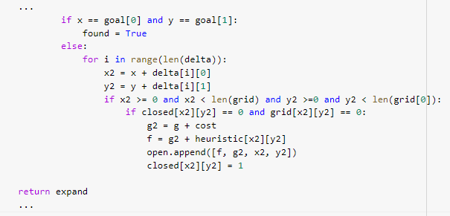
Define the algorithm
lab3.ipynb (Q.3a)
Note: same as Best First Search except:
g2 = g -> g2 = g + cost

Slide 55


Run and display results
lab3.ipynb (Q.3a)
Output

Slide 56
Comparisons on Best-first search and A-Star Search
Similarities
Evaluation Strategy:
Both algorithms use an evaluation function to select the most promising node to expand next.
Both maintain a priority queue (Open list) to manage nodes based on their evaluation.
Differences
Evaluation Function Components:
Greedy Best-first Search:
Uses only the heuristic function h(n) to select nodes.
Prioritizes nodes that appear closest to the goal based on h(n).
A Search:*
Uses the combined function f(n) = g(n) + h(n).
Considers both the actual cost from the start g(n) and the heuristic estimate to the goal h(n).

Slide 57
Optimality, Completeness, and Key Refinements
Optimality Guarantee:
A Search:*
Guarantees an optimal solution if the heuristic h(n) is admissible (does not overestimate the true cost) and consistent.
Greedy Best-first Search:
Does not guarantee optimality due to reliance solely on h(n).
Completeness:
A Search:*
Complete under conditions like finite branching and positive step costs.
Greedy Best-first Search:
May not be complete; can get stuck in loops or miss existing solutions.

Slide 58
Comparison of the Search Algorithms
 | Breadth First Search | Dijkstra’s Search | Best First Search | A* Search
Priority queue ? | no | yes | yes | yes
Distance from start d(n) | no | yes | no | yes
Heuristic function h(n) | no | no | yes | yes
Optimal path ? | no | yes | no (but often yes) | yes
Computer resources | high | highest | low | quite high

Slide 59

Self Study Guide

Slide 60
Self Study Guide
References
Russell, S. and Norvig, P. (2020). Artificial Intelligence: A Modern Approach (4th ed.). Upper Saddle River, NJ: Pearson.
Joshir, P. (2017). Artificial Intelligence with Python (1st ed.). Birmingham: Packt Publishing.

Slide 61
Self Study Guide
Useful Sites
https://www.educative.io/edpresso/how-to-implement-a-breadth-first-search-in-python
https://gist.github.com/Kautenja/29f13b543ecd210202417dfc9e328249
https://github.com/ninopereira/A_Star_Python/blob/master/A_star.py

